Slide 2
Email Server Configuration and Customization (Scimail)
Minor - I
Mid-Term Presentation
on
Project Mentor
Dr. Monit Kapoor
Associate Professor,
HOD(Department of Cybernetics)

Slide 3
Motivation
SECURITY CONCERNS
Emails have become a greater part of our lives. The Email, one organized well, is the most effective means of communication for business. A lot of companies nowadays have their privacy factors, in which they prefer to keep their delicate data inside their organizations.
RELIABLE MODE OF COMMUNICATION
The customization done in the project are on the requirements that are generally required by the company to establish a smooth and reliable medium of communication with restriction of messages like maintaining the buffer log, automating the mail server to generate automatic backups, providing special restriction to unaccepted contents and to make the data searchable and easily accessible.

Slide 4
Objective
The Perform Customization of an email server to serve as per the constraints identified for an organization:
To inspect sensitive content in the mail and add constraints respective to it.
Maintain a log of all sensitive emails from the server.
To automate the process of Backup and deletion of logs.
Applying searching and sorting algorithm to buffer list for easy access.
Filtering the content and providing the security to the process by signing SSL, TSL Certifications.

Slide 5
Objectives achieved so far
Pilot POC of the code with architecture, rollback and all the binaries.
Implemented filtering of mail based on sensitive content, and if a mail contains sensitive content then the mail is marked as flagged and logs of such mail are maintained for administration purposes.
Designed a completely scripted package that provides the user with a UI (Java AWT) to send mail via postfix and in the backend, it inspects the mail for any sensitive content and thus performs filtration process.

Slide 6
Filtering of mails
In every organization, some privacy factors are needed to be followed by the employees. (Here privacy factors refers to any sensitive information related to the organization or some other purposes which must always remain in the organization itself).Even the employees must never use such a language which may lead to having issues in inter-organization or intra-organization.
Email is the primary source of communication in intra-organization or inter-organization. Thus every organization must have their email servers customized in such a way that the emails sent by their employees must be always filtered so that they get to know if any employee is breaking the boundaries.
Filtering of email is done on its content and is based on the resources (i.e. files which tells what is the sensitive content that should not be used in email).
The resource files are needed to be maintained and updated by the organization on regular intervals.

Slide 7
SCIMAIL
Scimail is the name which we have given to our scripted package , which when executed performs various code such as java AWT code for UI interface and C code providing functionality for filtering of mail based on sensitive content, and thus makes it all possible by running just one command in the shell.
The codes executed after running this shell command also sends mail using postfix and in the backend filtering is performed on the sent mail and so the backup of flagged mails (i.e. mails with sensitive content) is maintained.

Slide 8
Algorithm
INTERIM ALGORITHM
In our project, we are using linear search algorithm to compare the values between two different files, i.e. the mail file (containing the entered values by the client for sending of mail) and the dictionary (containing the sensitive word).
If any string or value in dictionary is in the mail content then the mail is having sensitive content and it is then flagged for administration purposes.
For Project Scaling:
As we scale the project, traffic on the server increases, linear search algorithm’s responsiveness decreases and the code may not handle the traffic well. To increase efficiency while scaling up the project we will be implementing a Hash Mapping or M-way search tree.

Slide 9
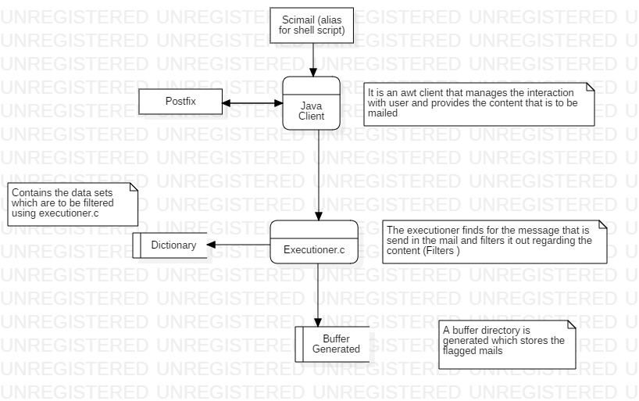
DFD DIAGRAM

Slide 10
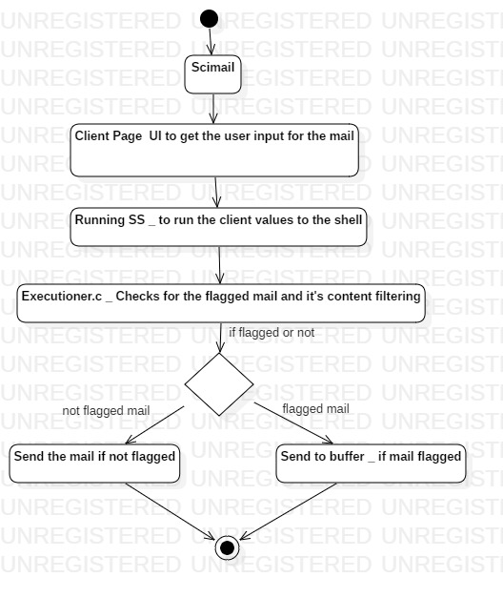
ACTIVITY DIAGRAM

Slide 11
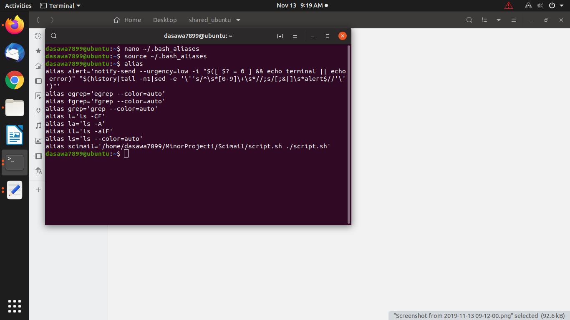
Scimail Workflow
Fig 1: Editing of bash_alias file

Slide 12
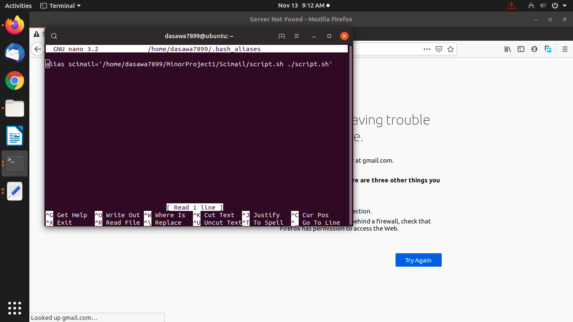
Fig 2: Setting of alias named ‘scimail’

Slide 13
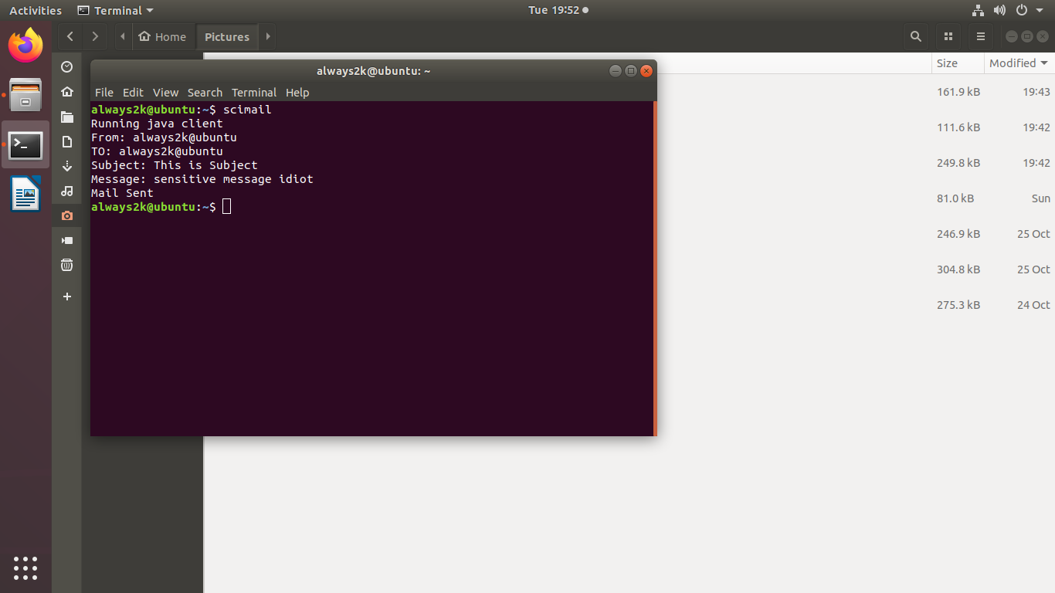
Sample Mail 1: Mail with sensitive content
Fig 3: Execution of scimail command

Slide 14
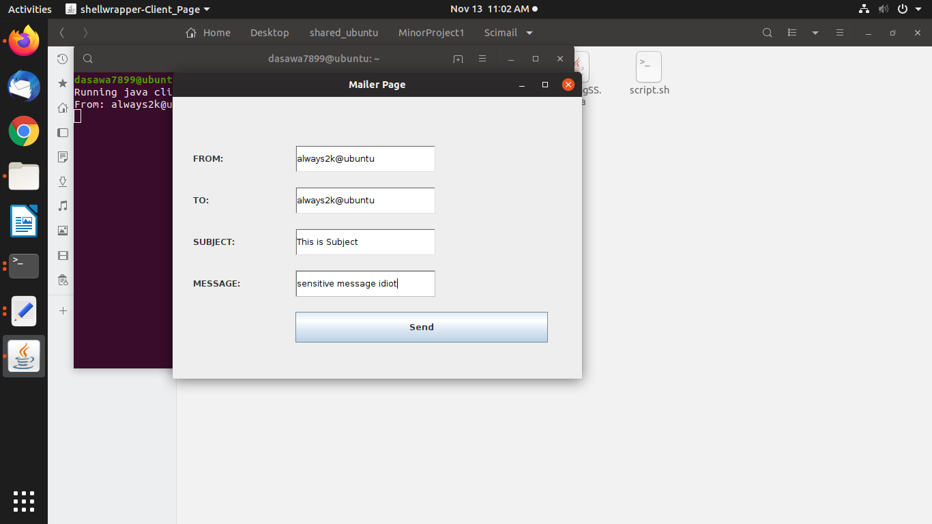
Fig 4: Java AWT interface

Slide 15
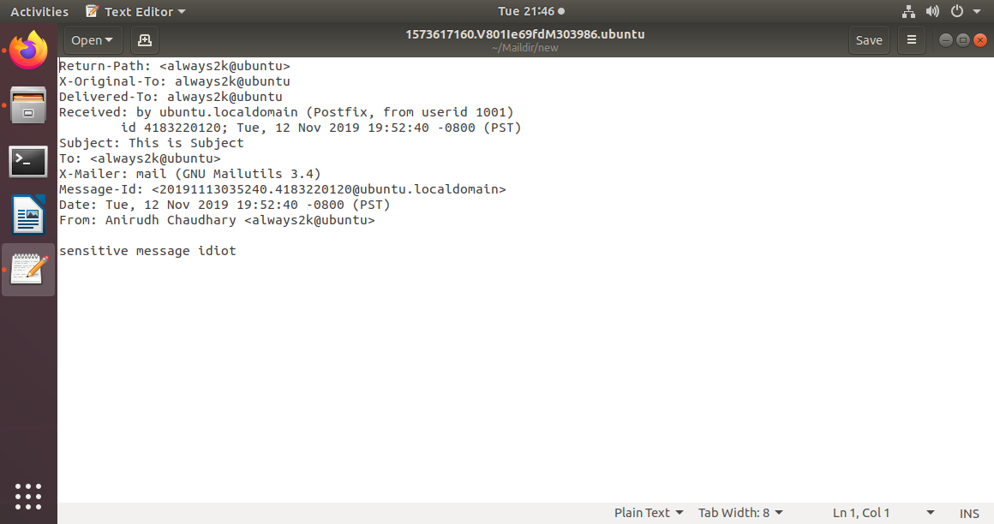
Fig 5: Mail sent via postfix (using SMTP)

Slide 16
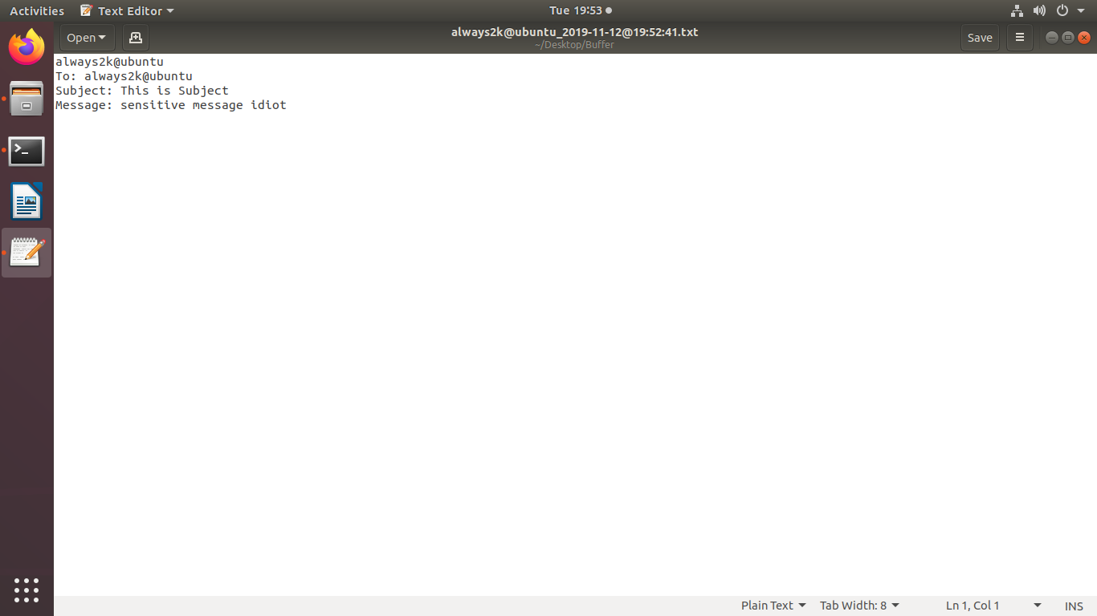
Fig 6: Sensitive content found, new file create in buffer directory

Slide 17
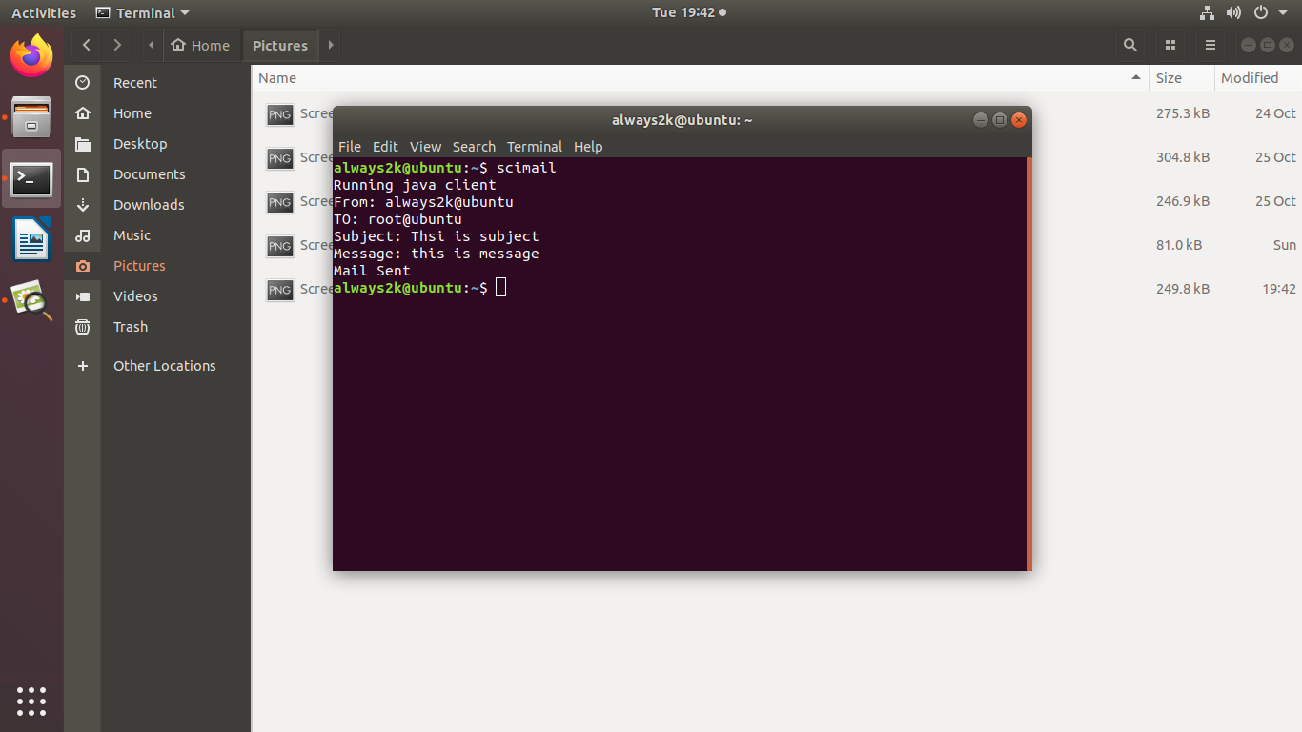
Sample Mail 2: Mail without sensitive content
Fig 7: Execution of scimail command

Slide 18
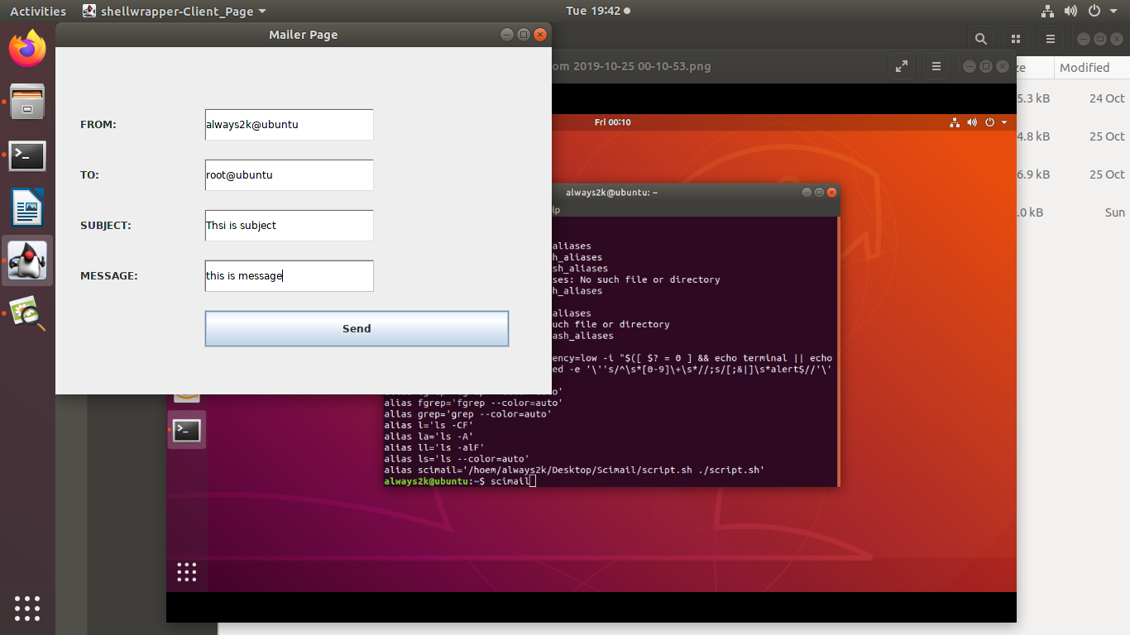
Fig 8: Java AWT interface

Slide 19
Fig 9: Mail sent via Postfix (using SMTP)

Slide 20
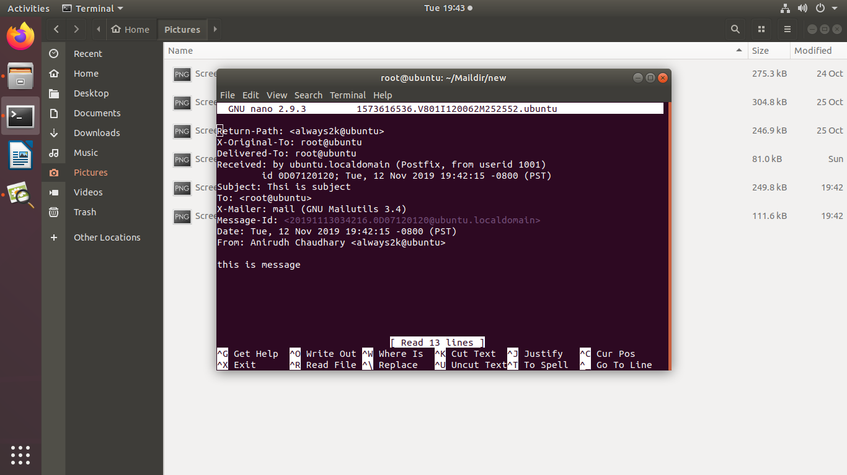
Fig 10: Mail Received via postfix

Slide 21
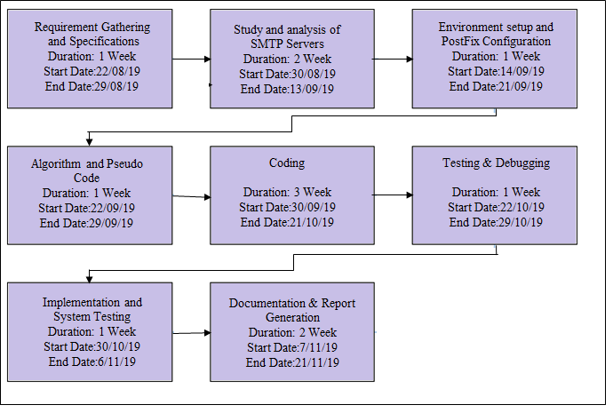
Pert Chart
Fig 3: PERT chart for the minor project

